Slide 1
Online Bookstore Sales & Product Analysis
Analysis of Pricing, Ratings, Availability and Marketing Insights

Slide 2
Key Performance Indicators
Average Price: $35.07
Stock Availability: 100.00%
Price vs Rating Correlation: 0.03
2. What is the average price of all books?
Ans: The average price of all books is $35.07.
10. Which popular or high-rated books are running out of stock?
Ans: In this dataset, there are no high-rated books which are just out of stock.

Slide 3
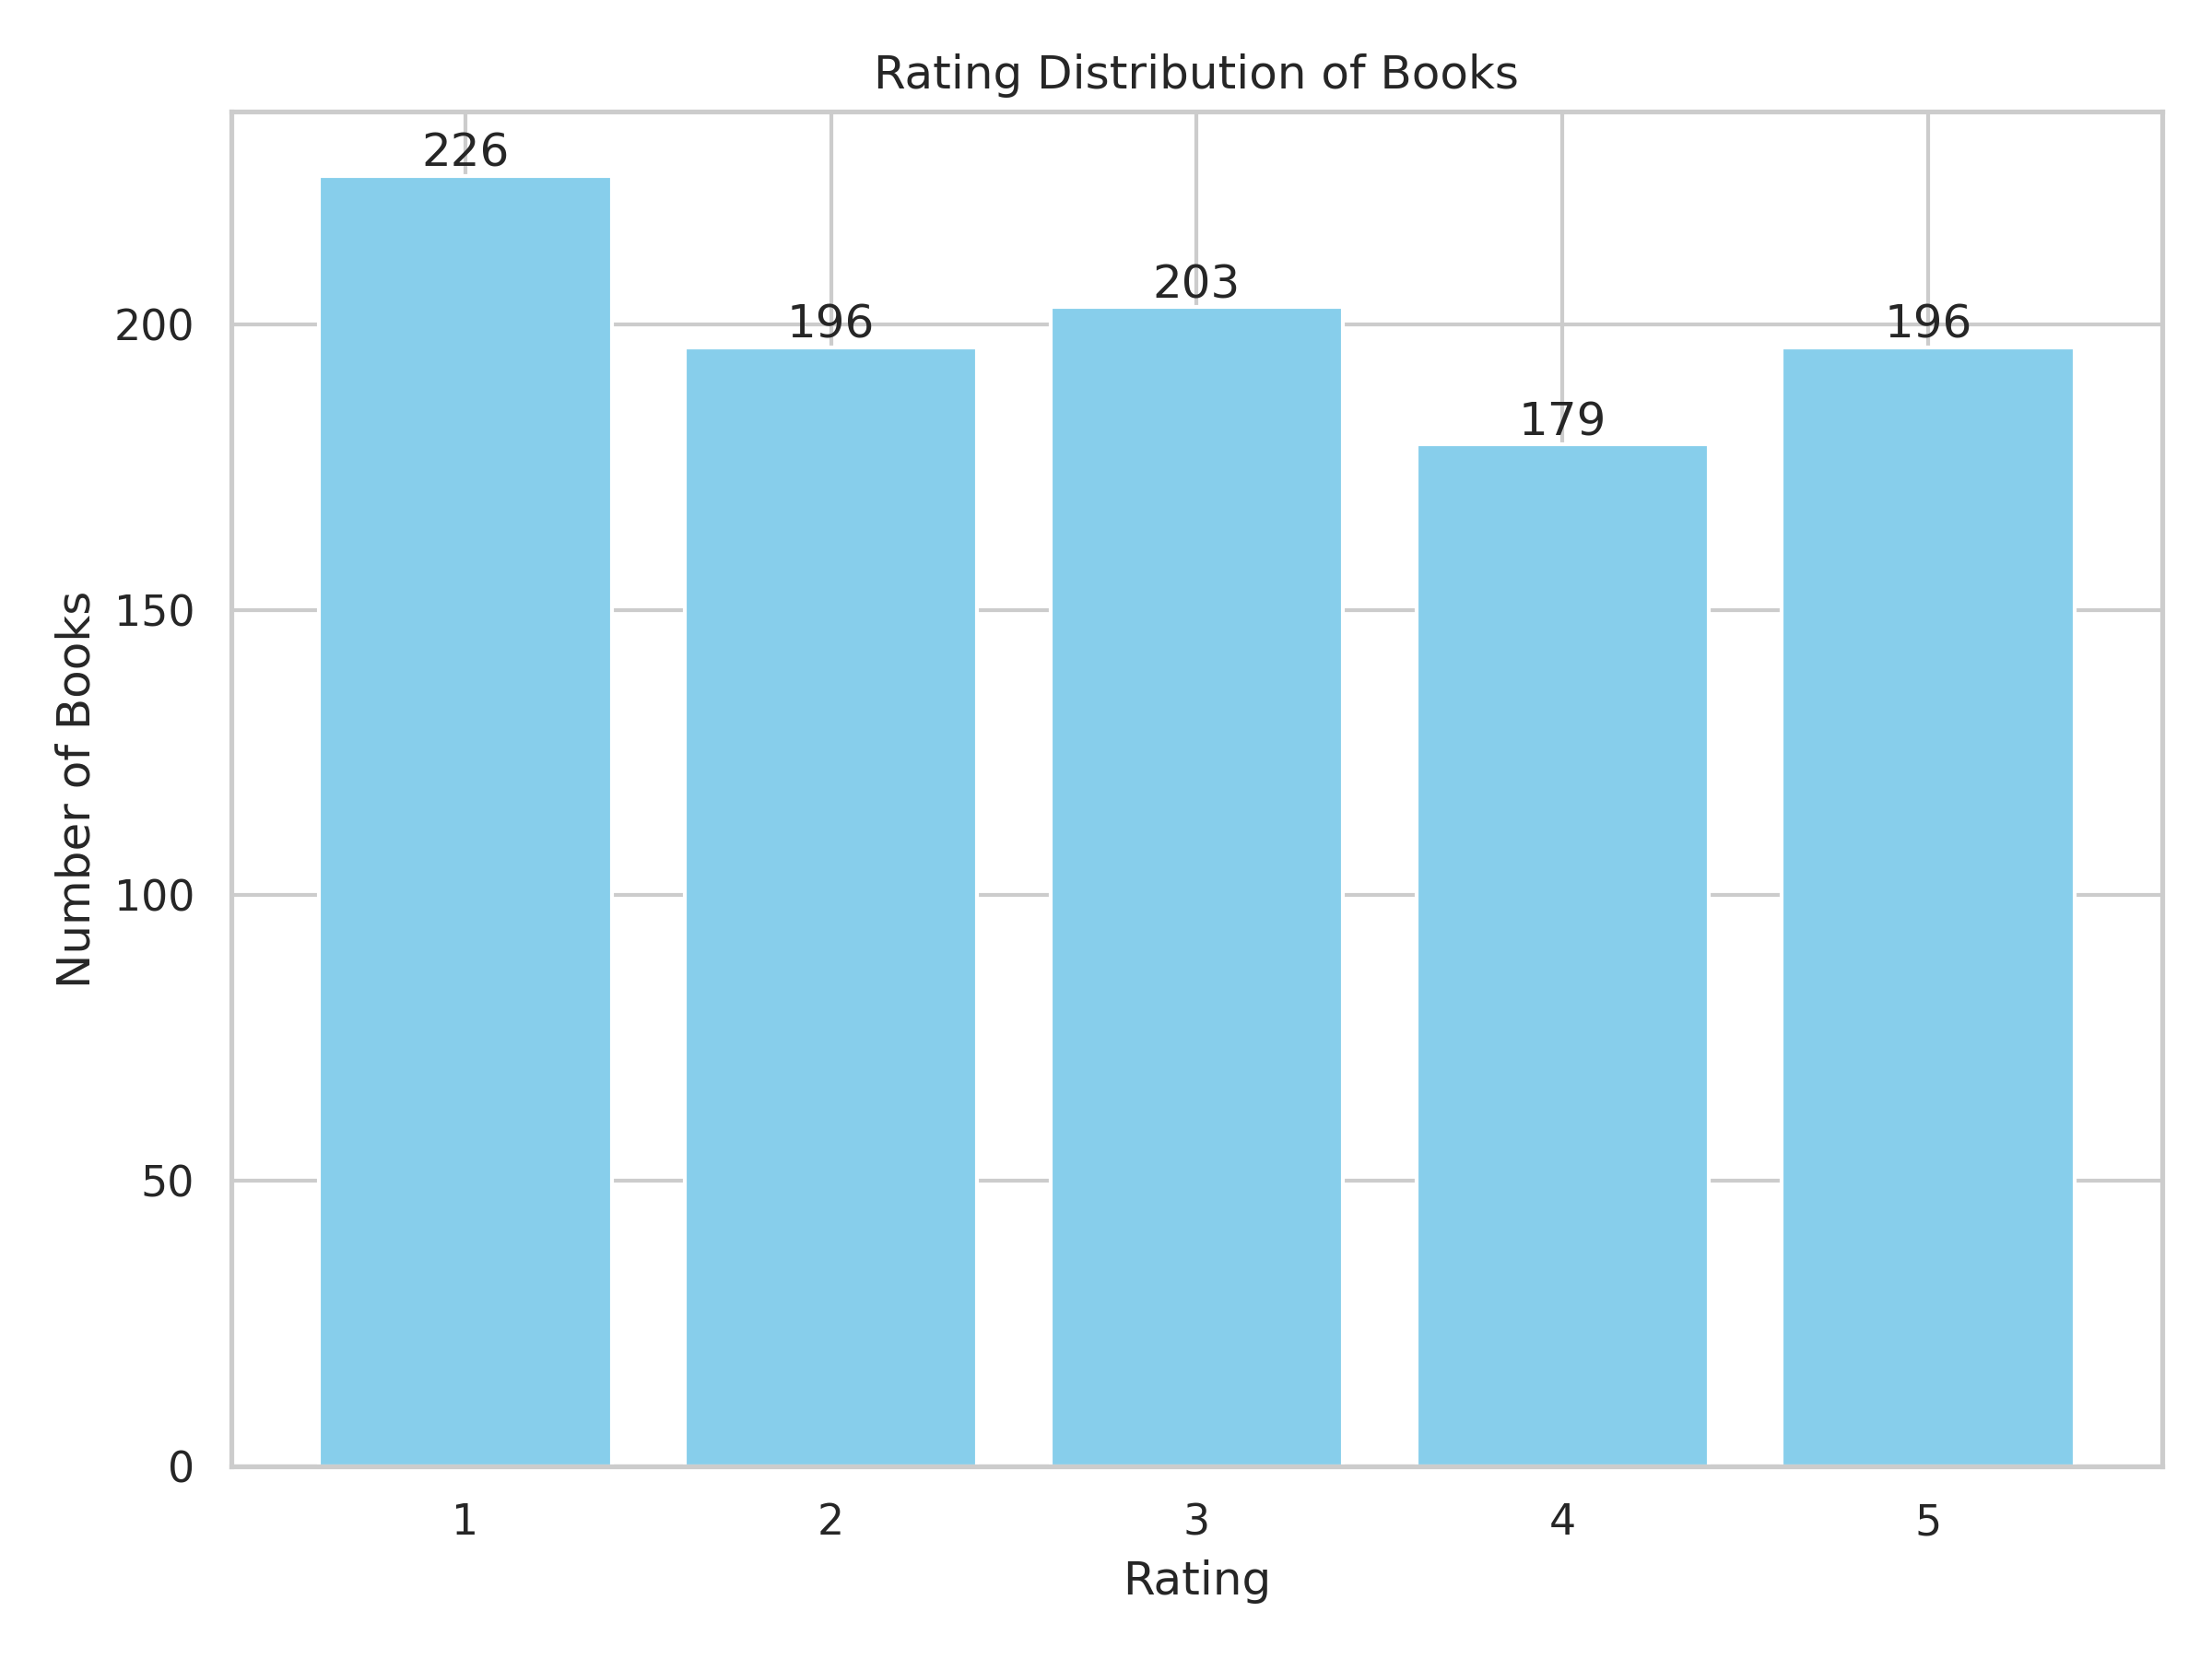
Rating Distribution

Slide 4
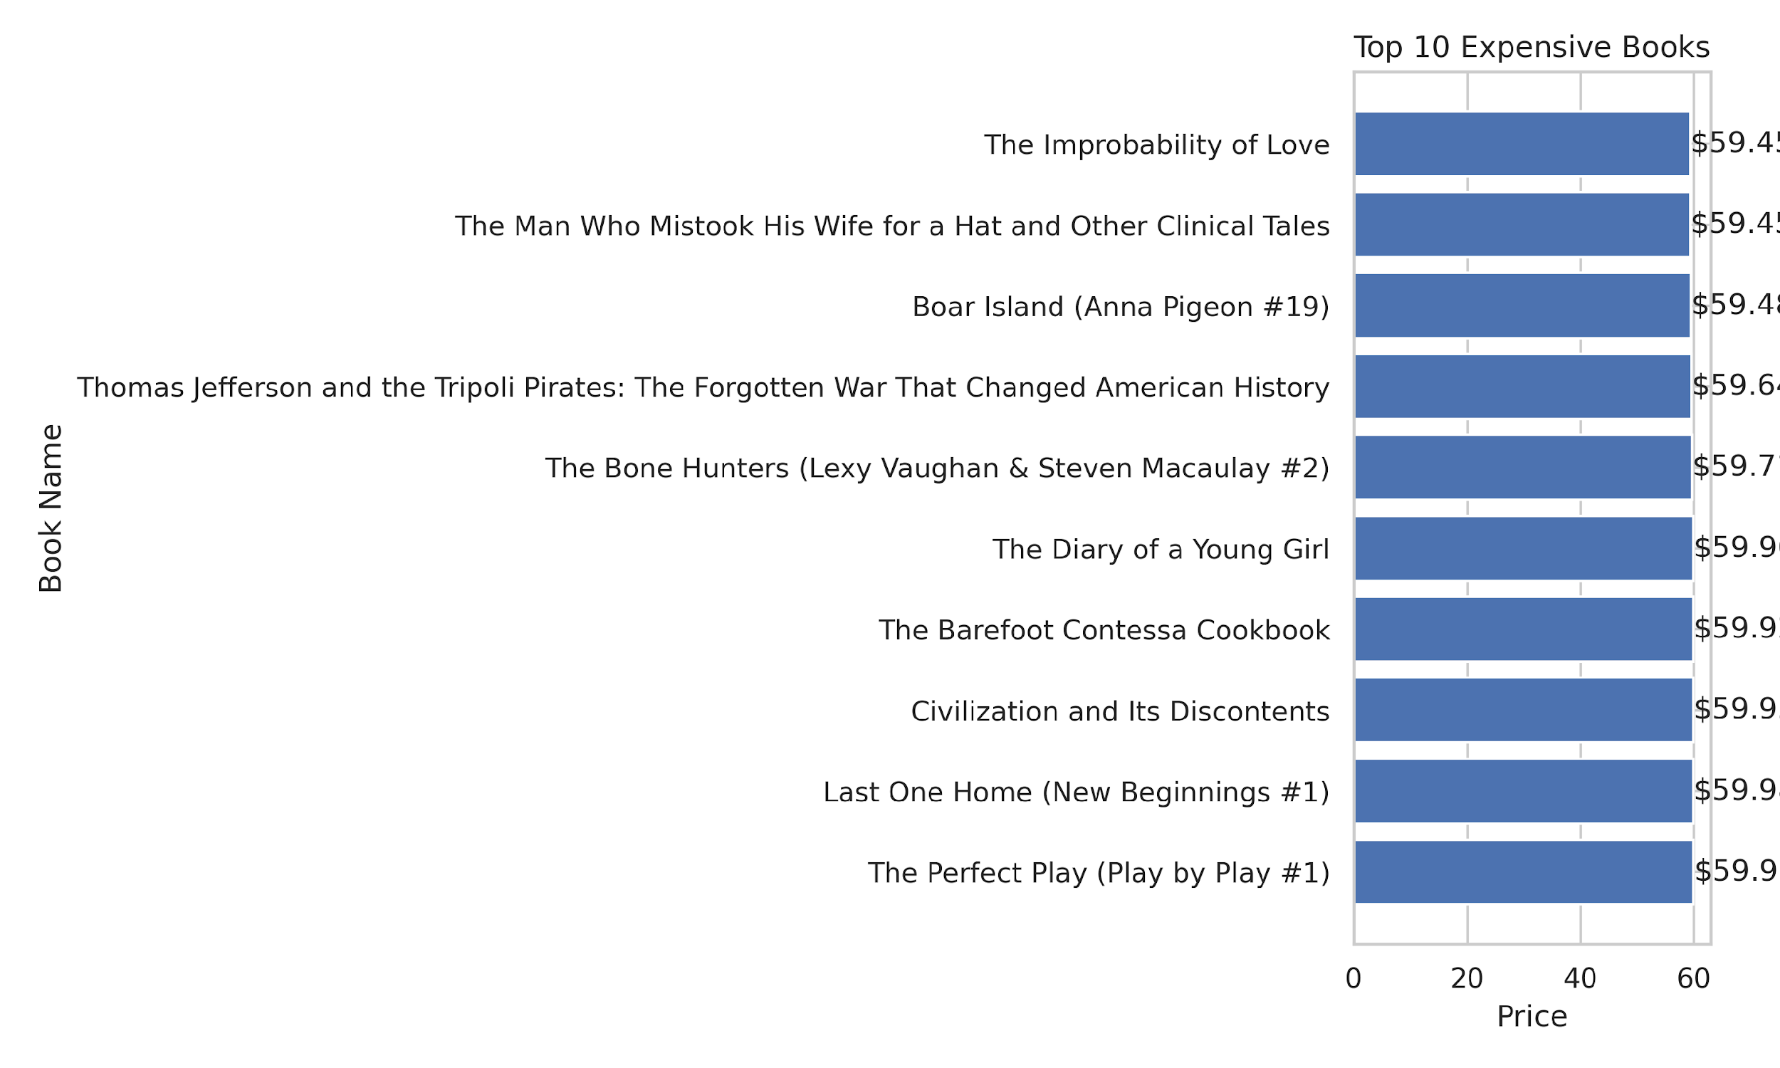
Top 10 Expensive Books

Slide 5
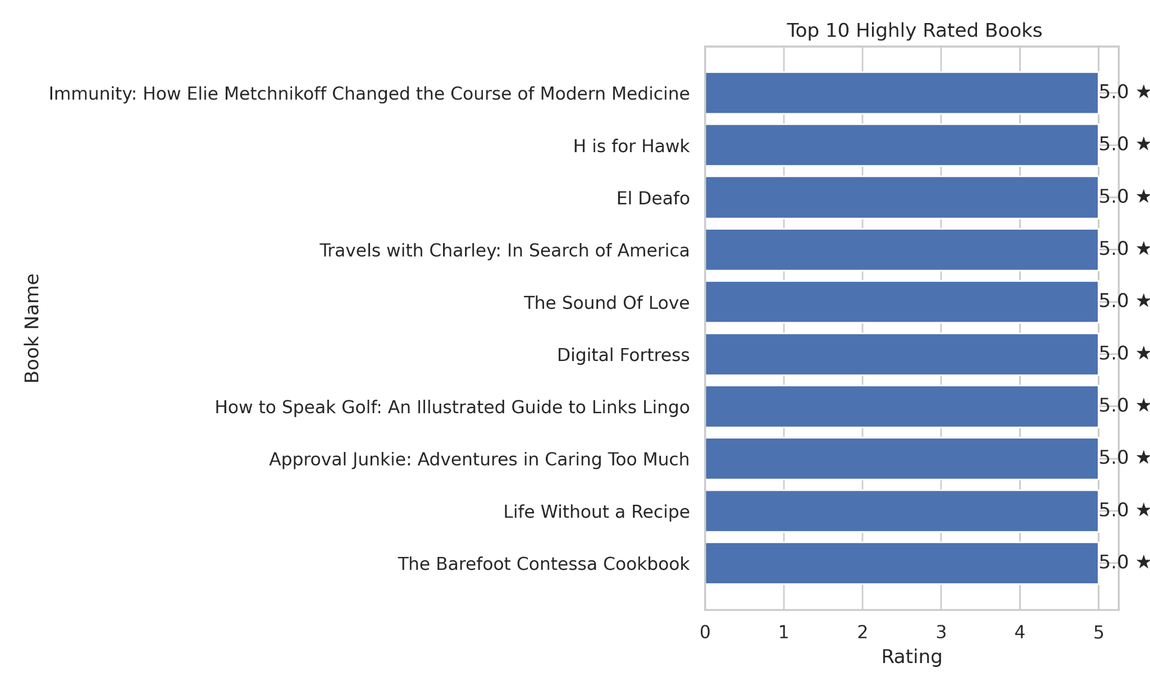
Top 10 Highly Rated Books

Slide 6
Which books are the most expensive and which are the cheapest?
Top 10 Expensive Books:

Slide 7
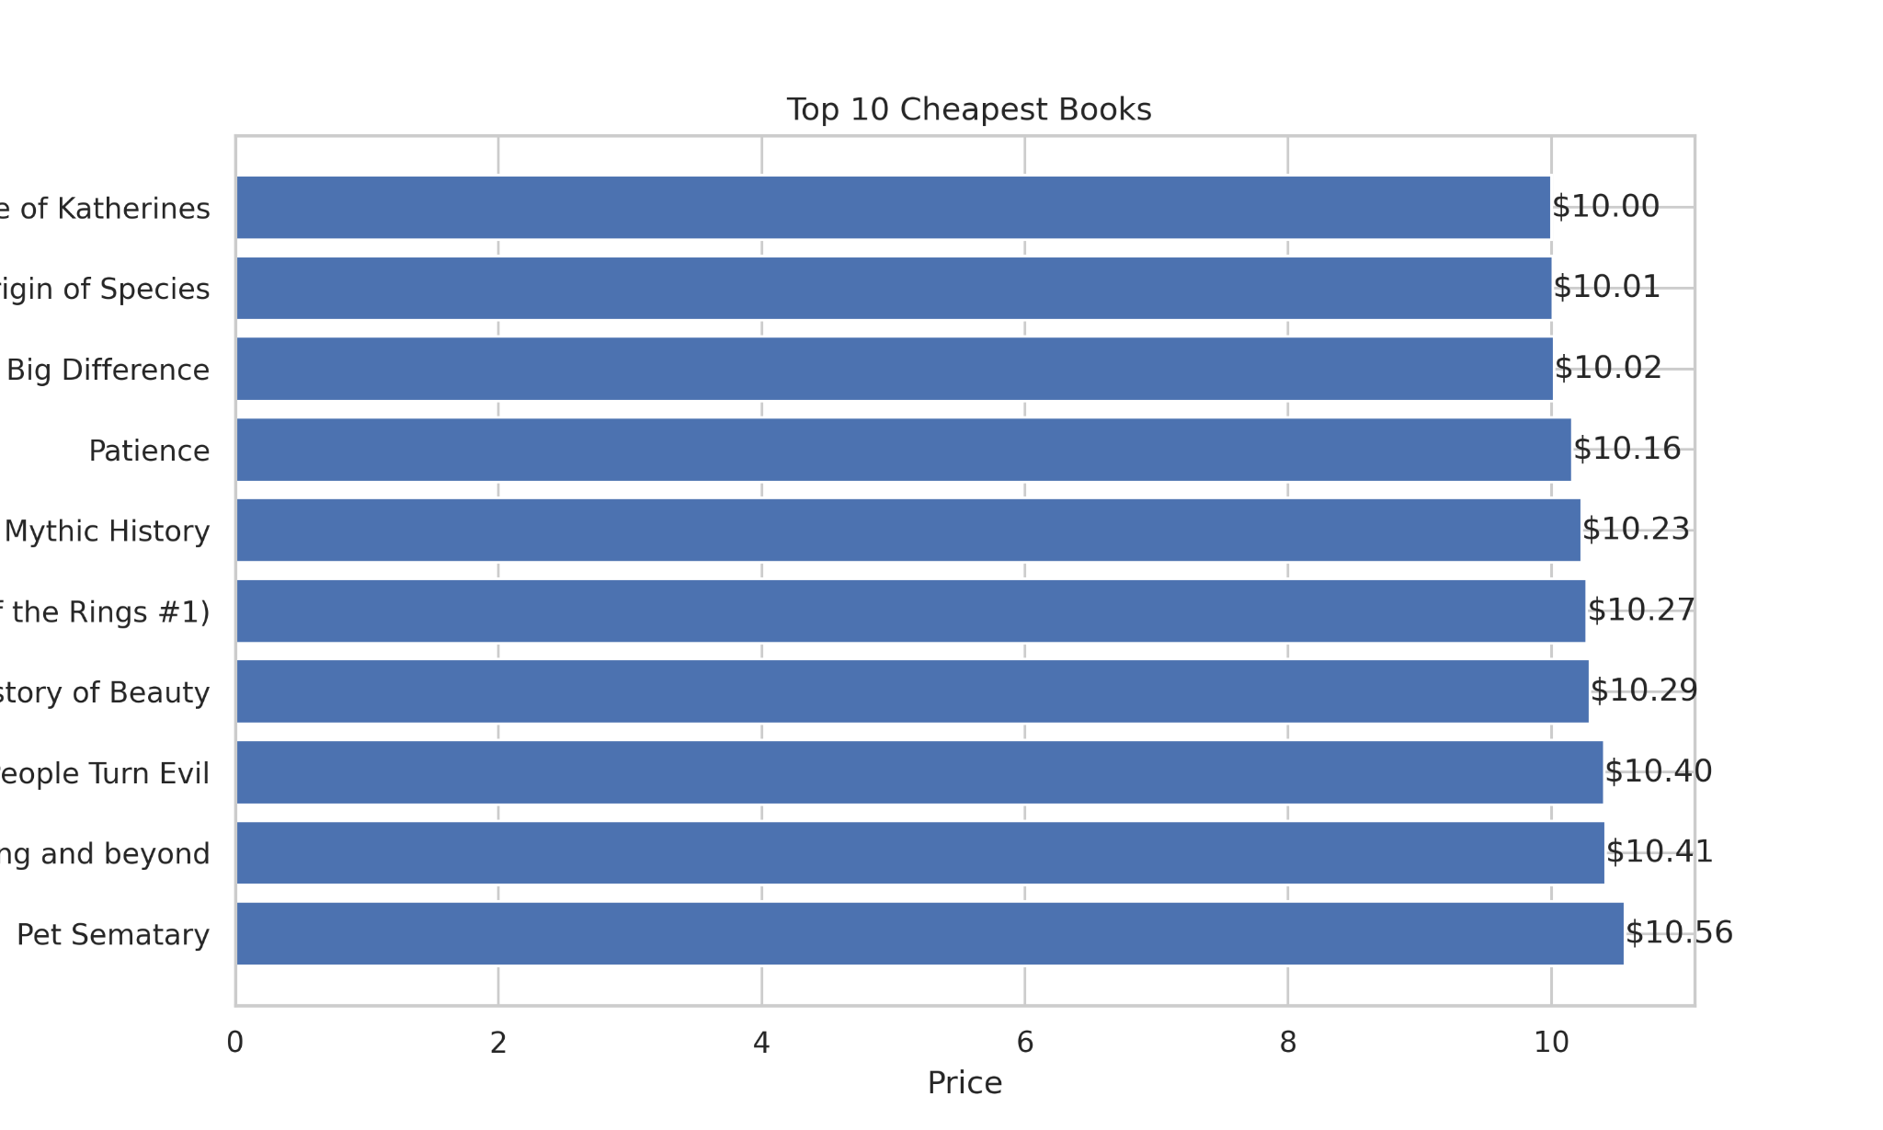
Top 10 Cheapest Books

Slide 8
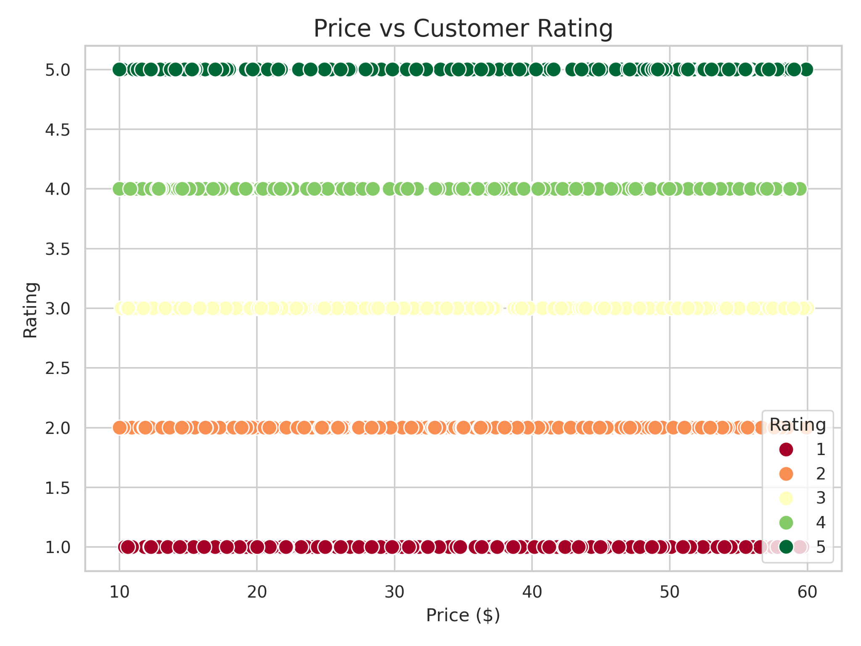
3. Is there a pattern between book price and customer rating?

Slide 9
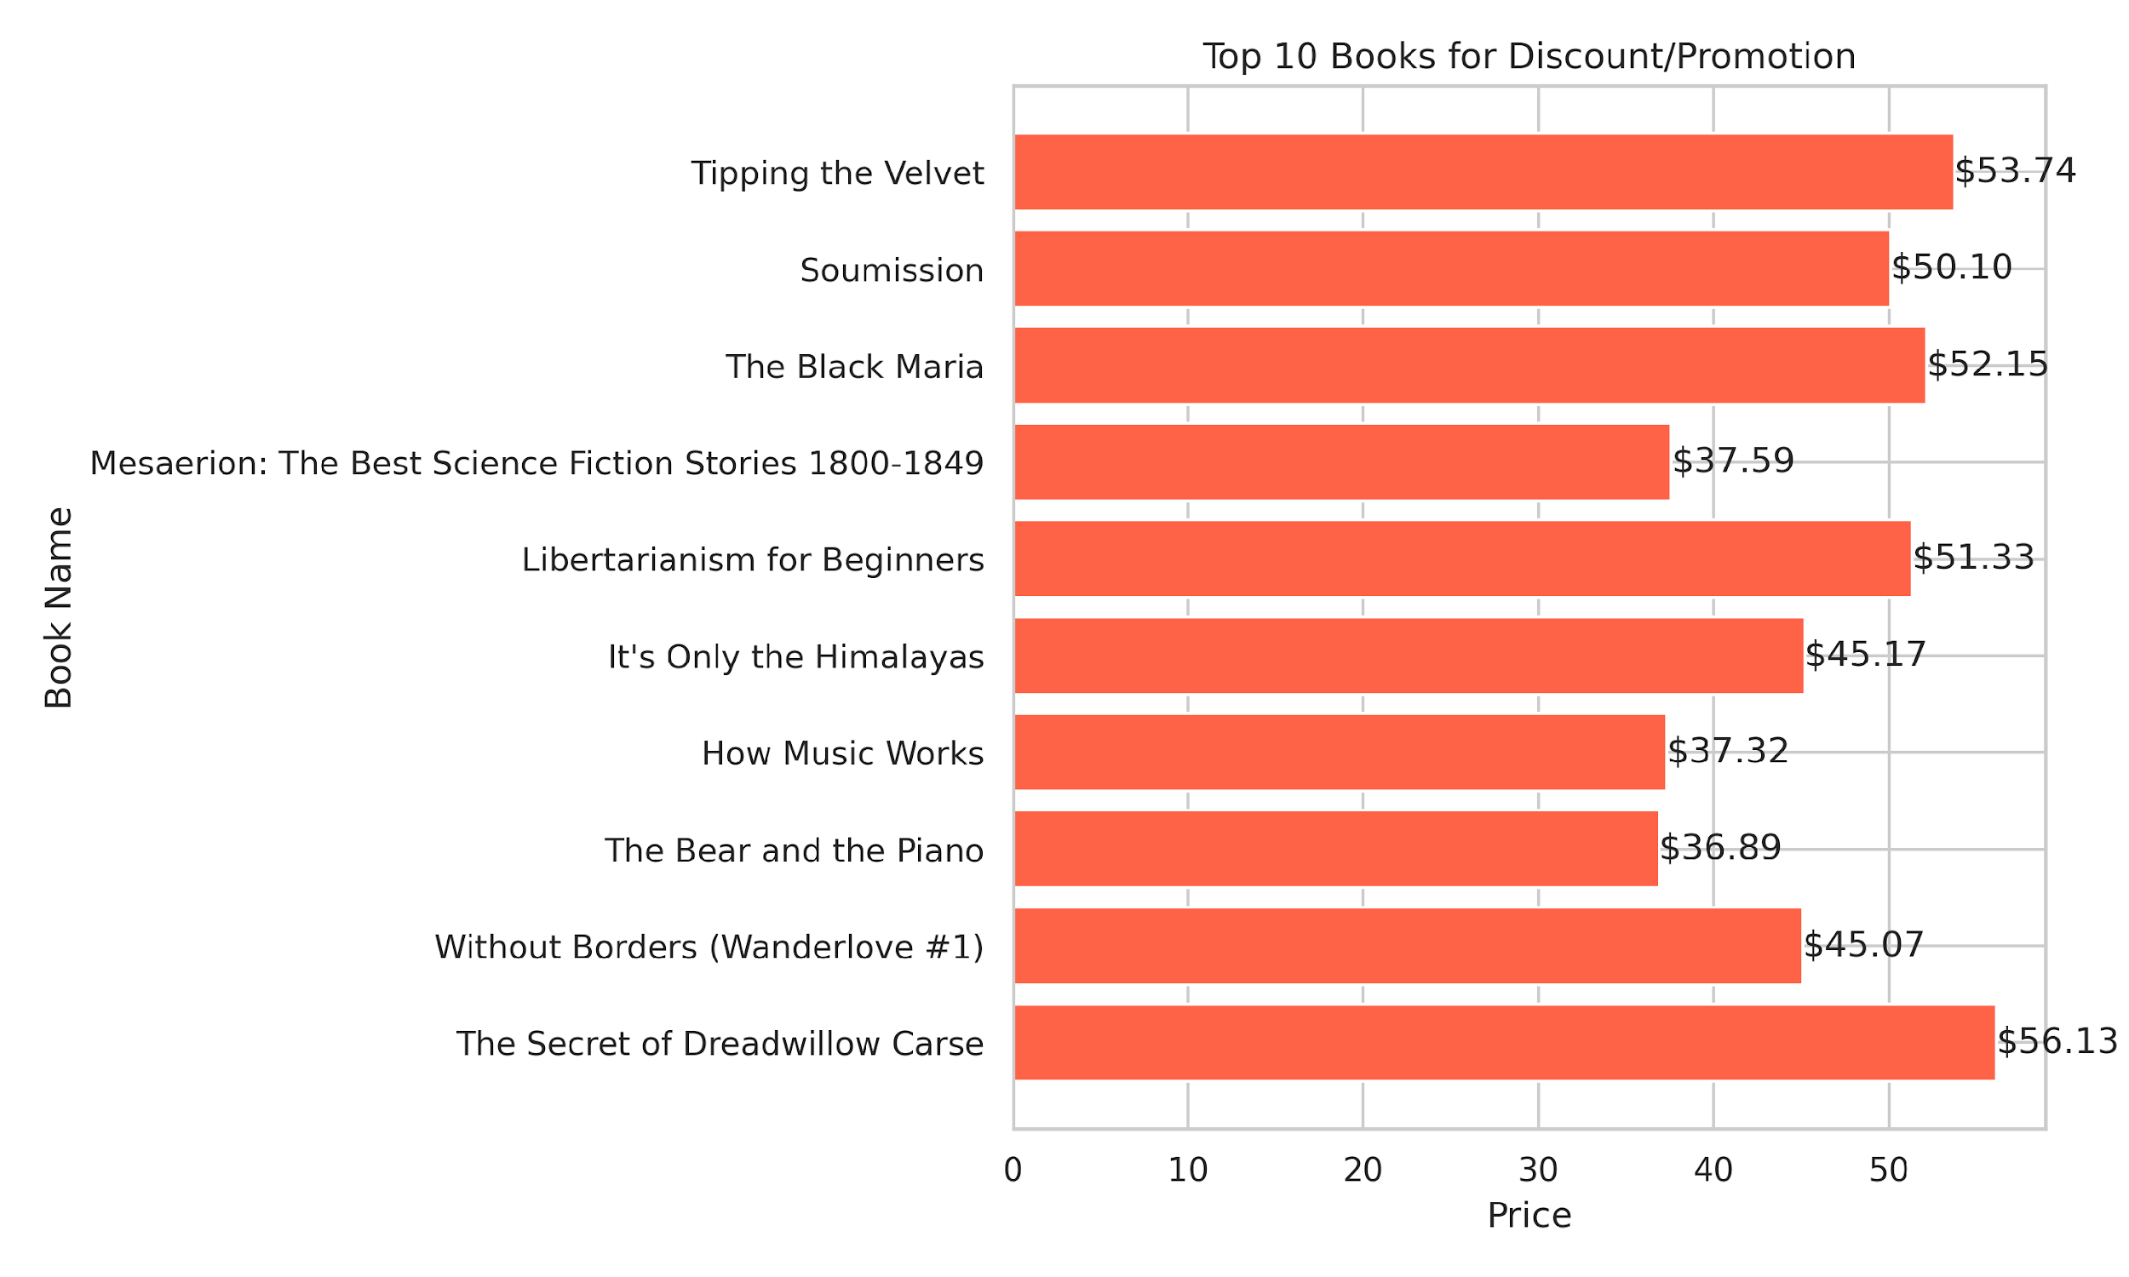
4. Which books could be candidates for discount or promotion?

Slide 10
How many books fall under each rating category (One to Five)?

Slide 11
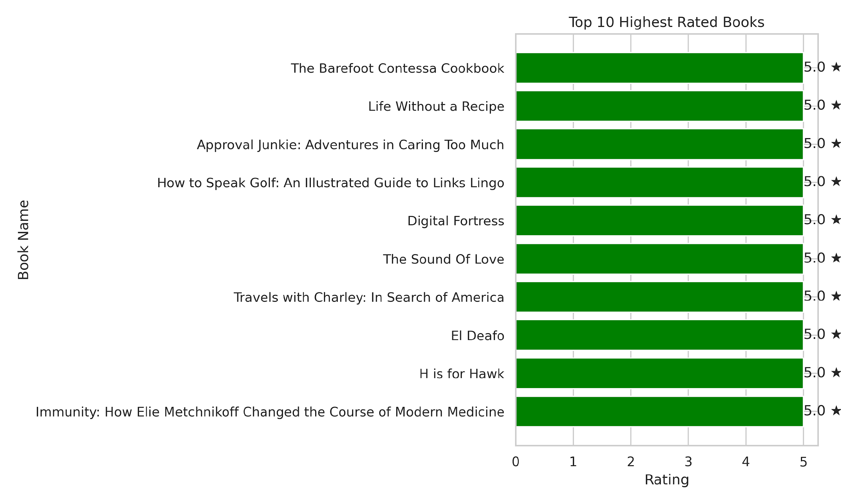
6. Which books have the highest ratings?

Slide 12
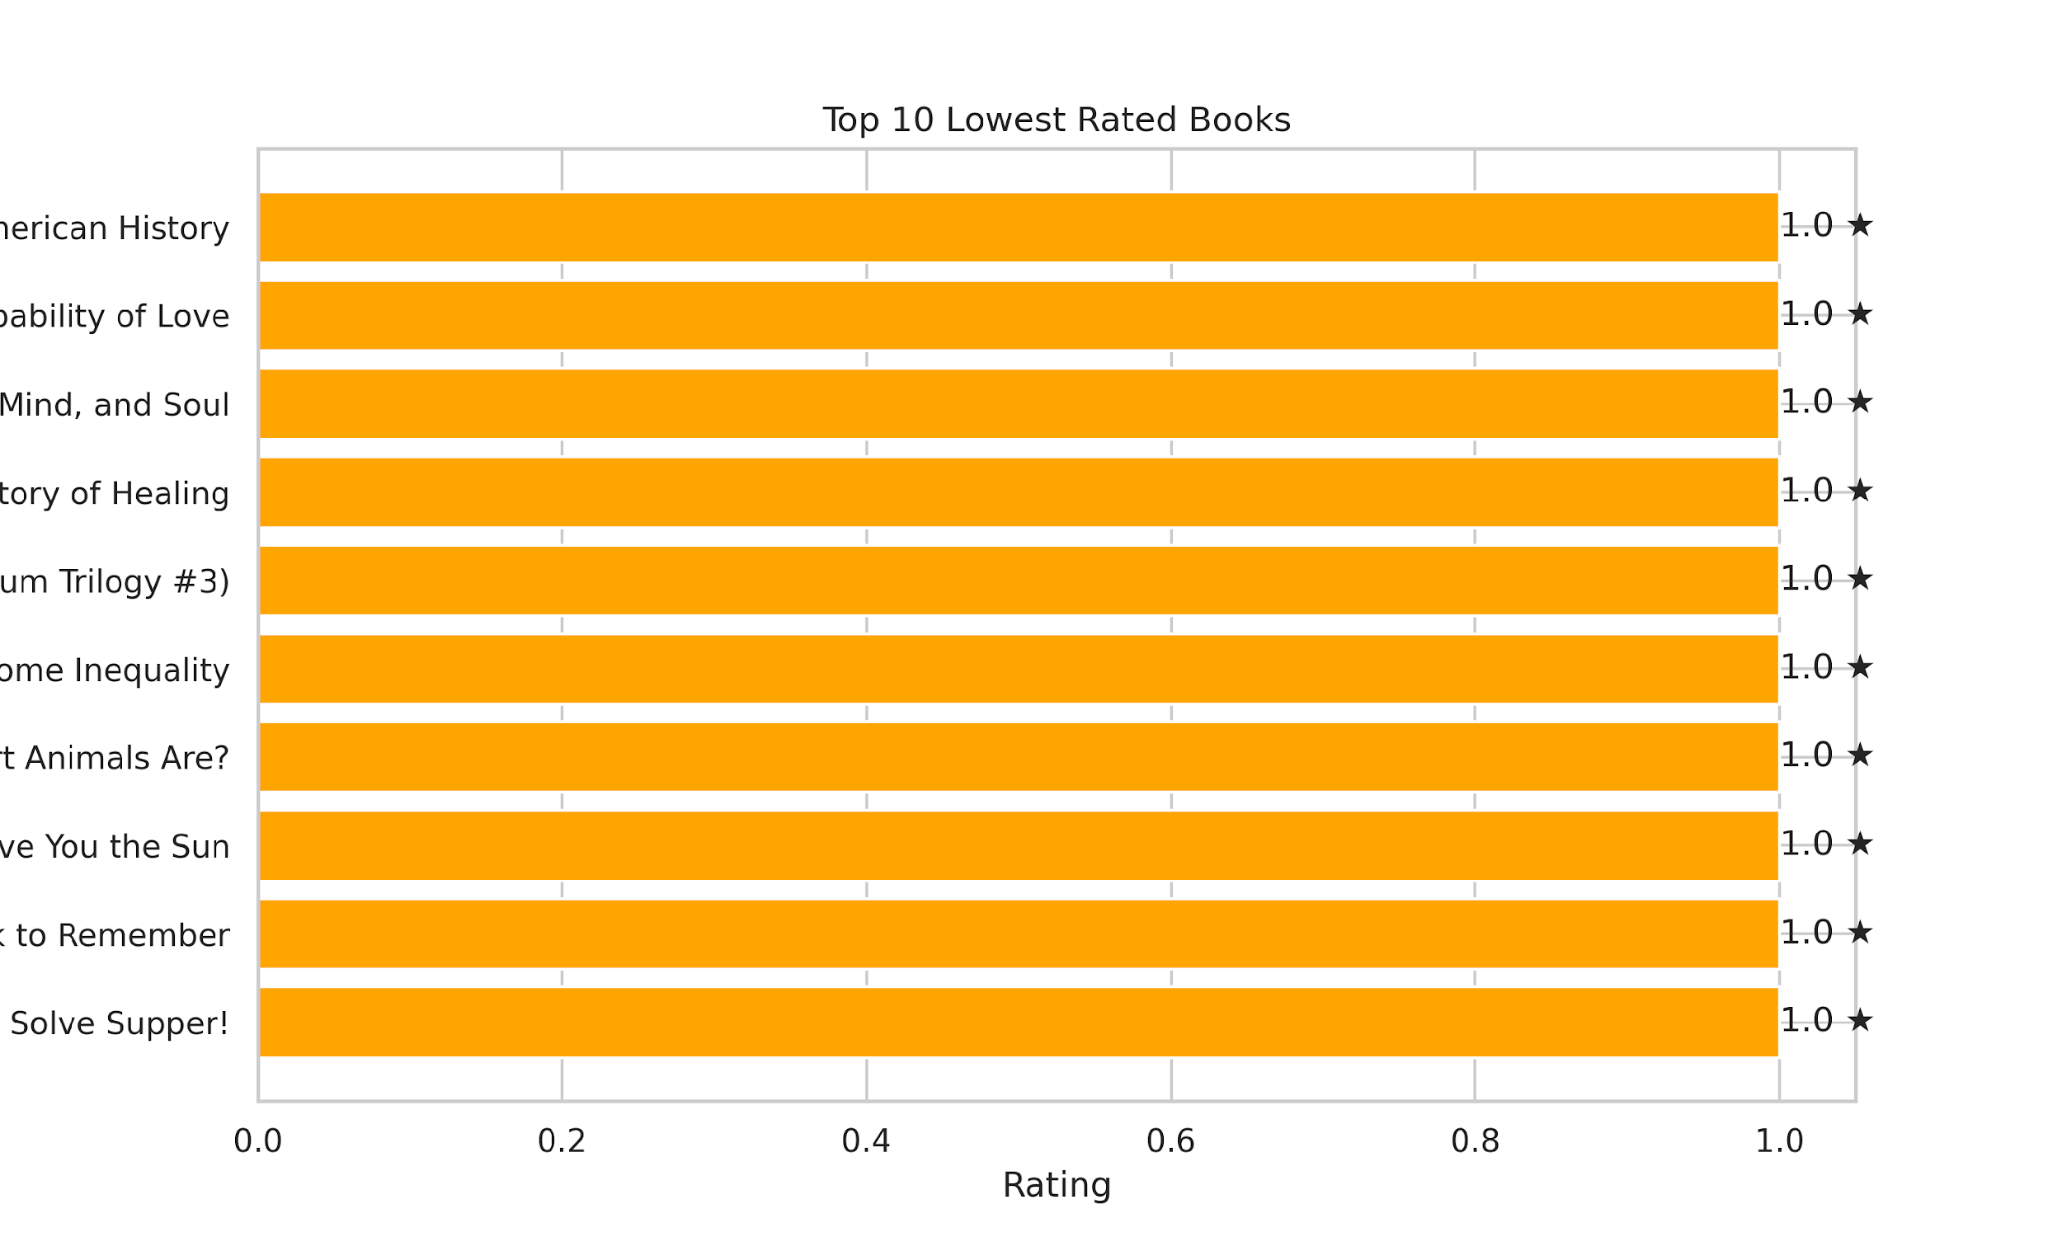
7. Which books have the lowest ratings?

Slide 13
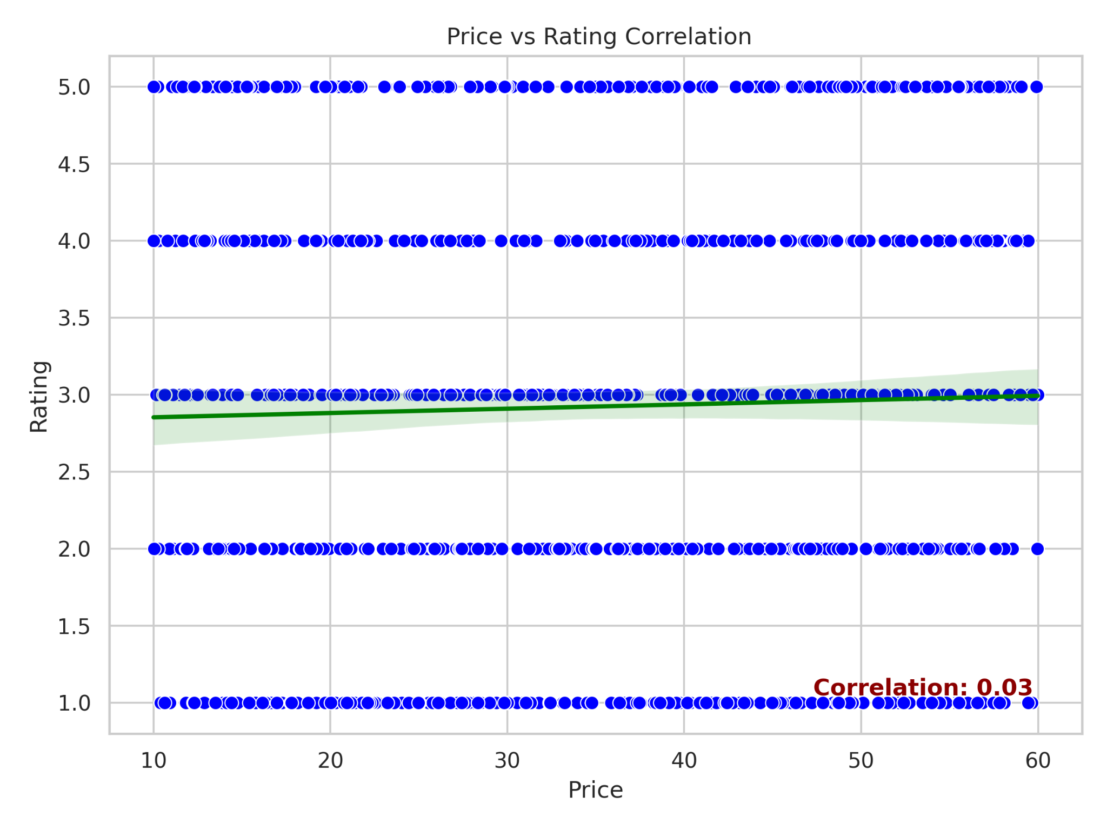
8. Are higher-priced books rated better than lower-priced ones?

Slide 14
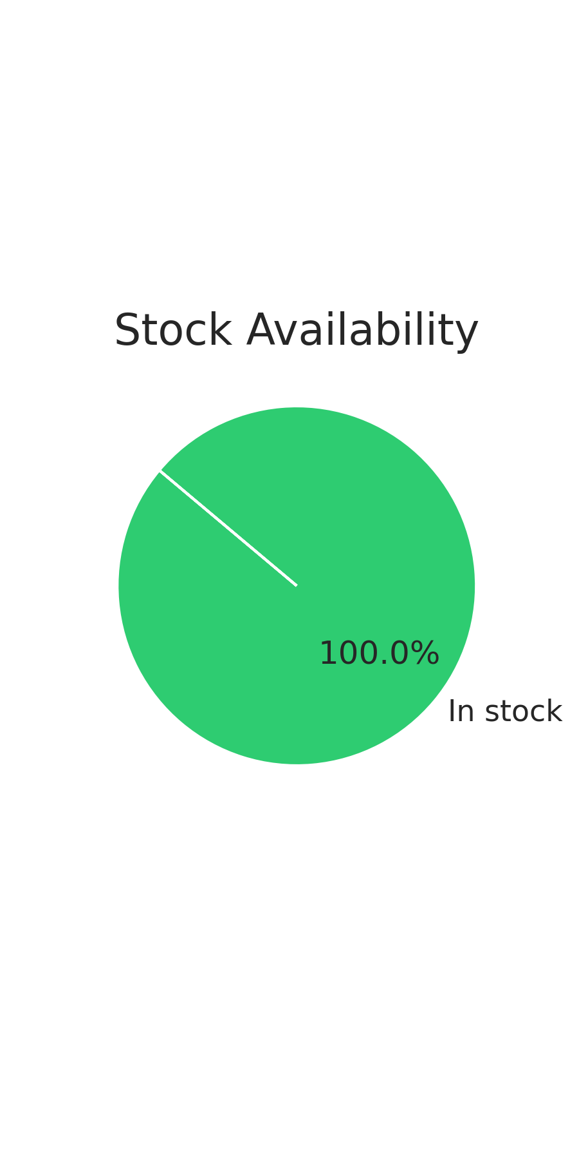
9. How many books are currently in stock vs out of stock?

Slide 15
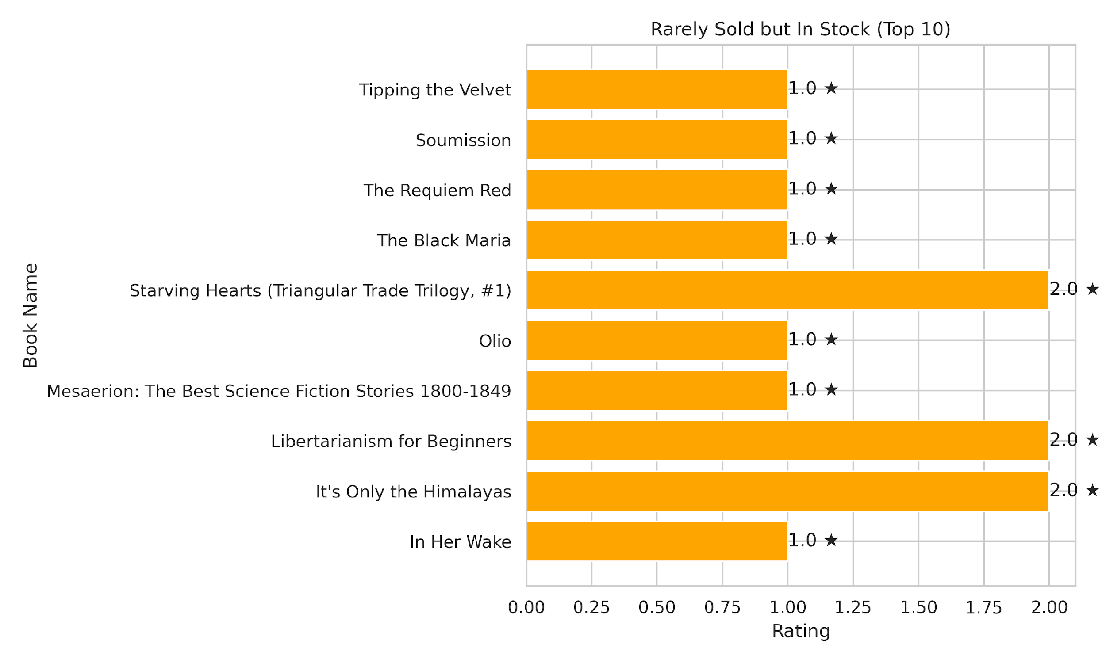
11. Are there books that are rarely sold but always in stock?

Slide 16
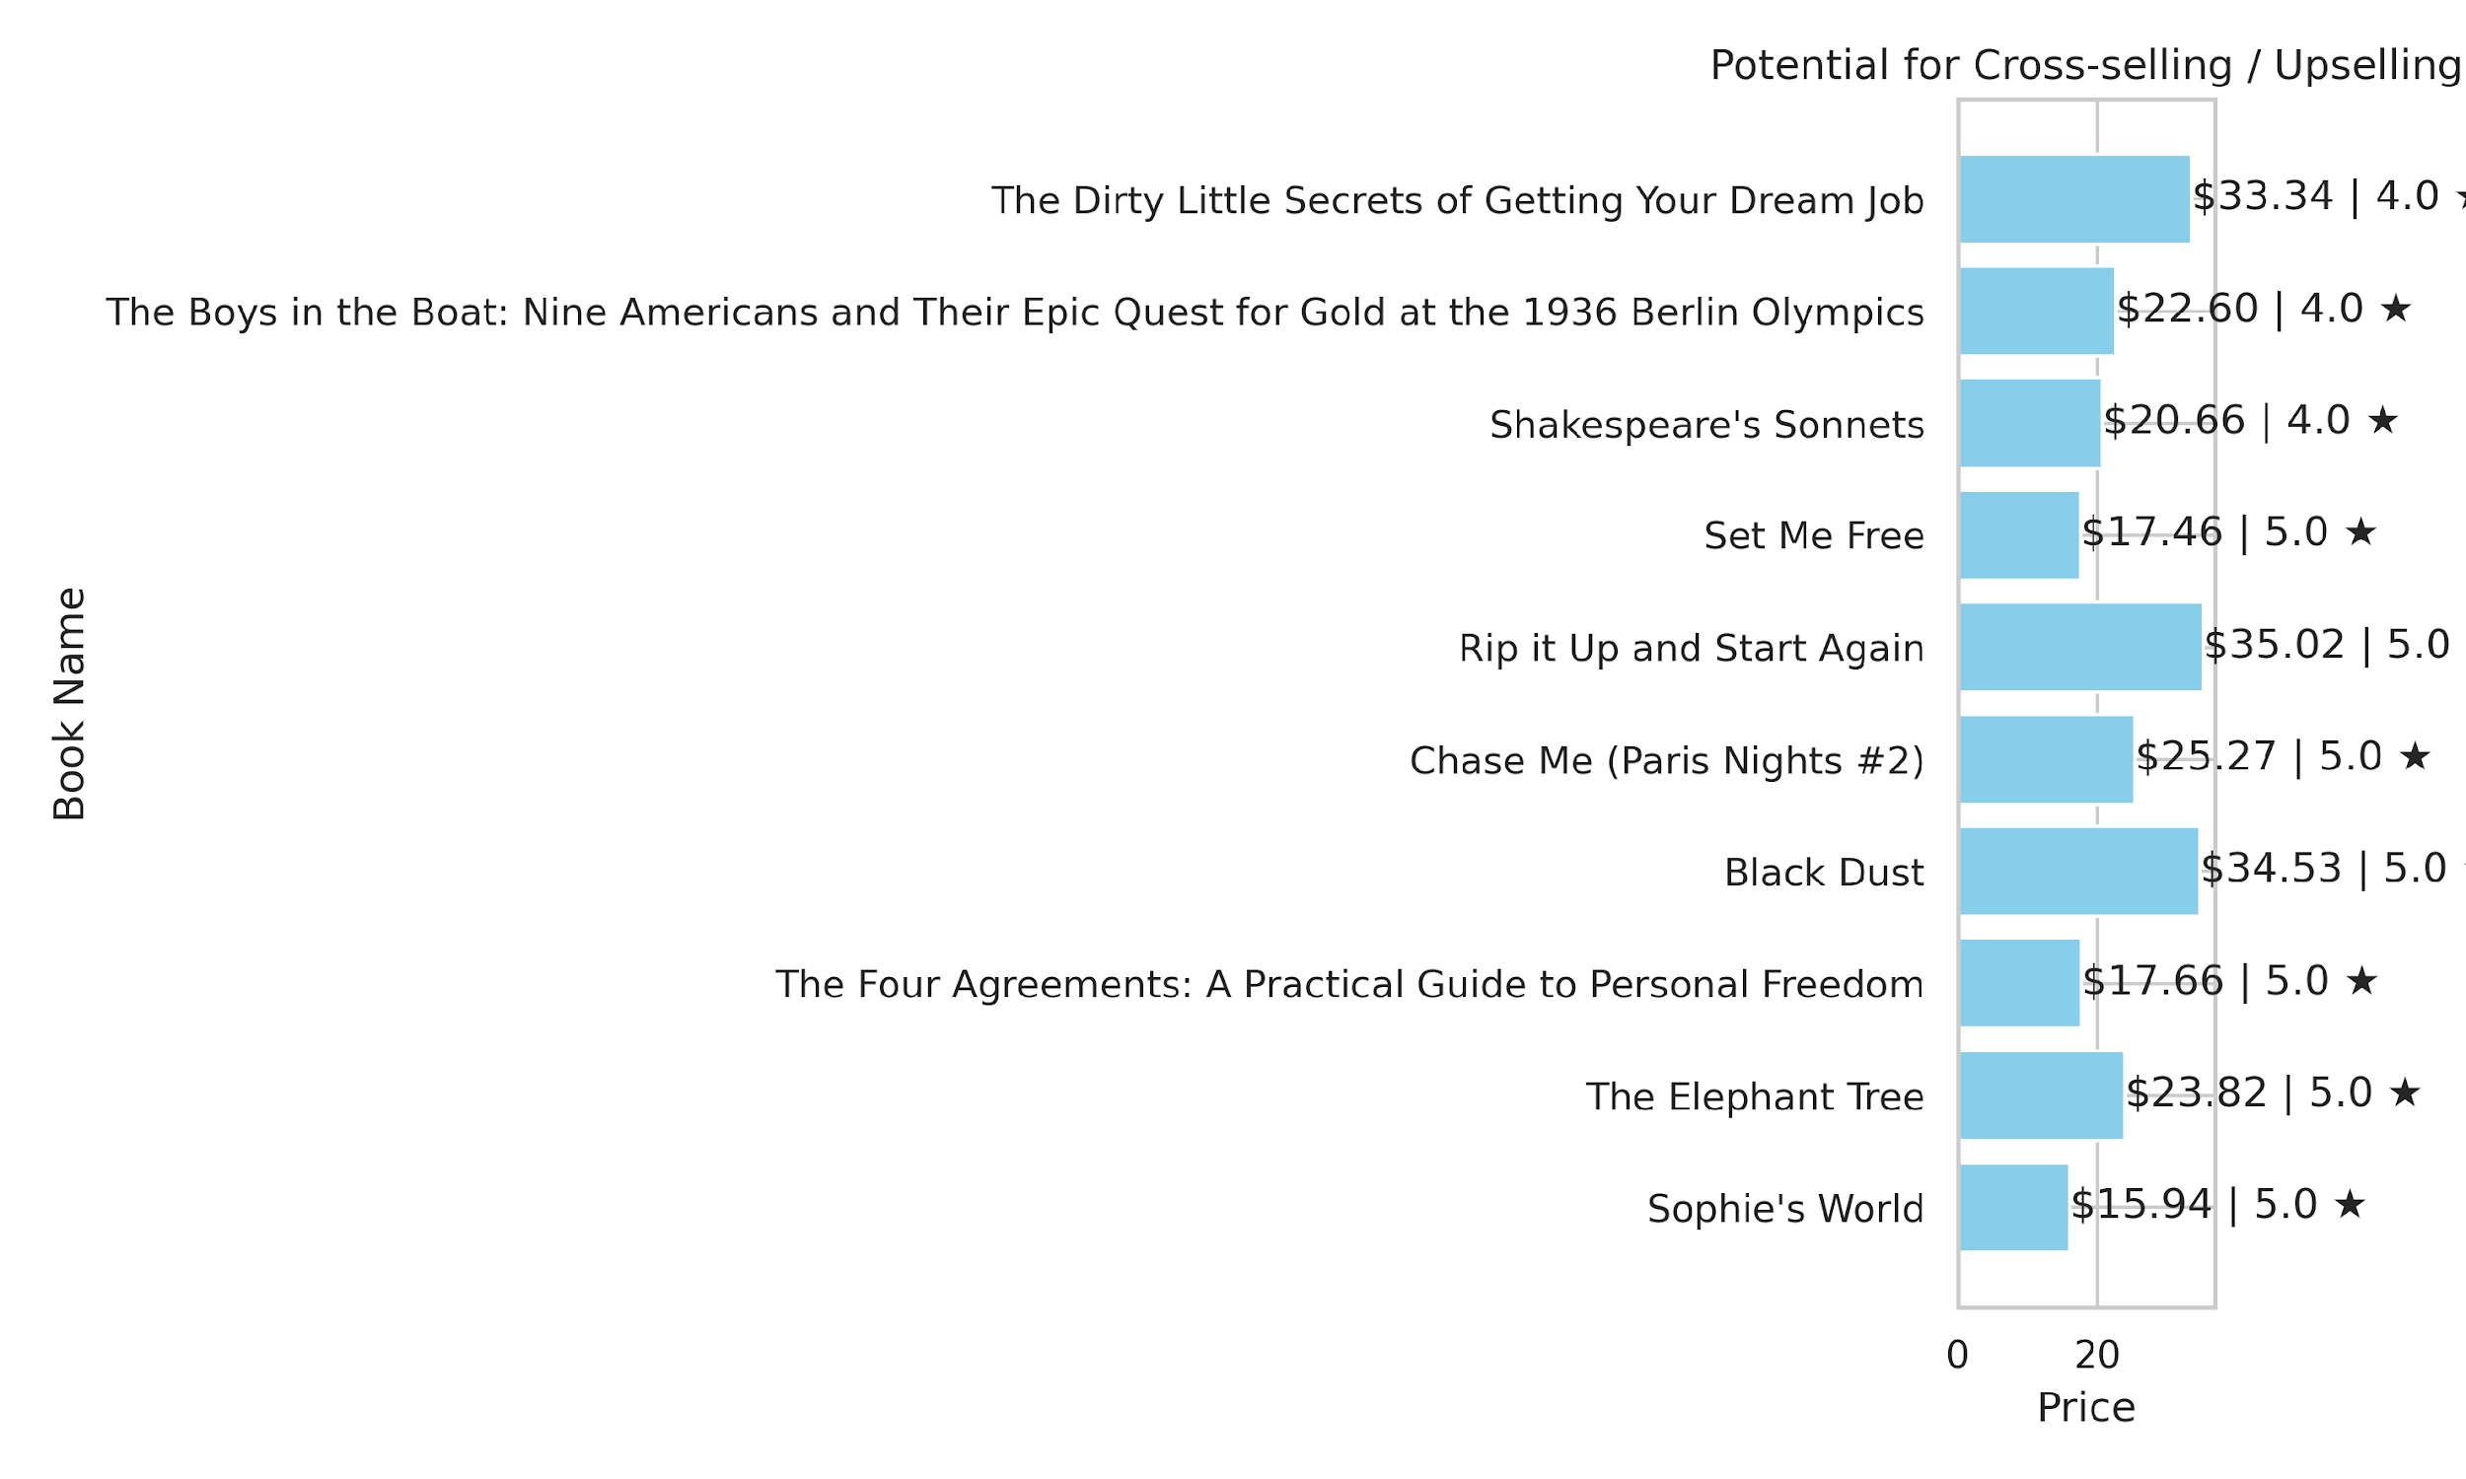
12. Which books have the most potential for cross-selling or upselling?

Slide 17
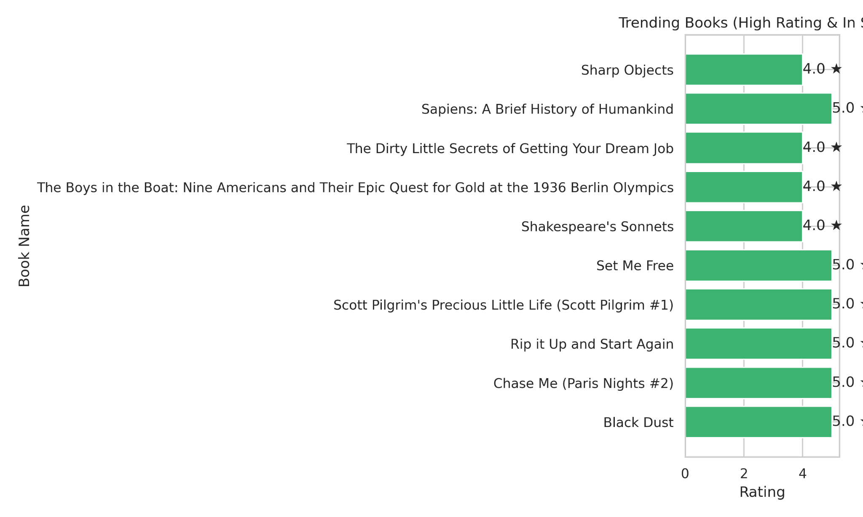
13. Can we identify books that are trending based on ratings and availability?

Slide 18
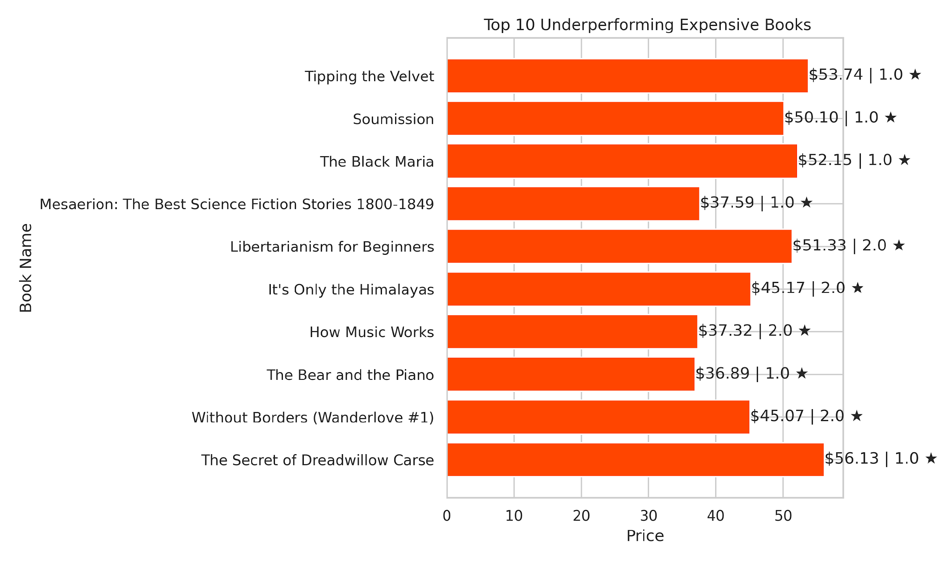
14. Which books are underperforming despite being expensive?

Slide 19
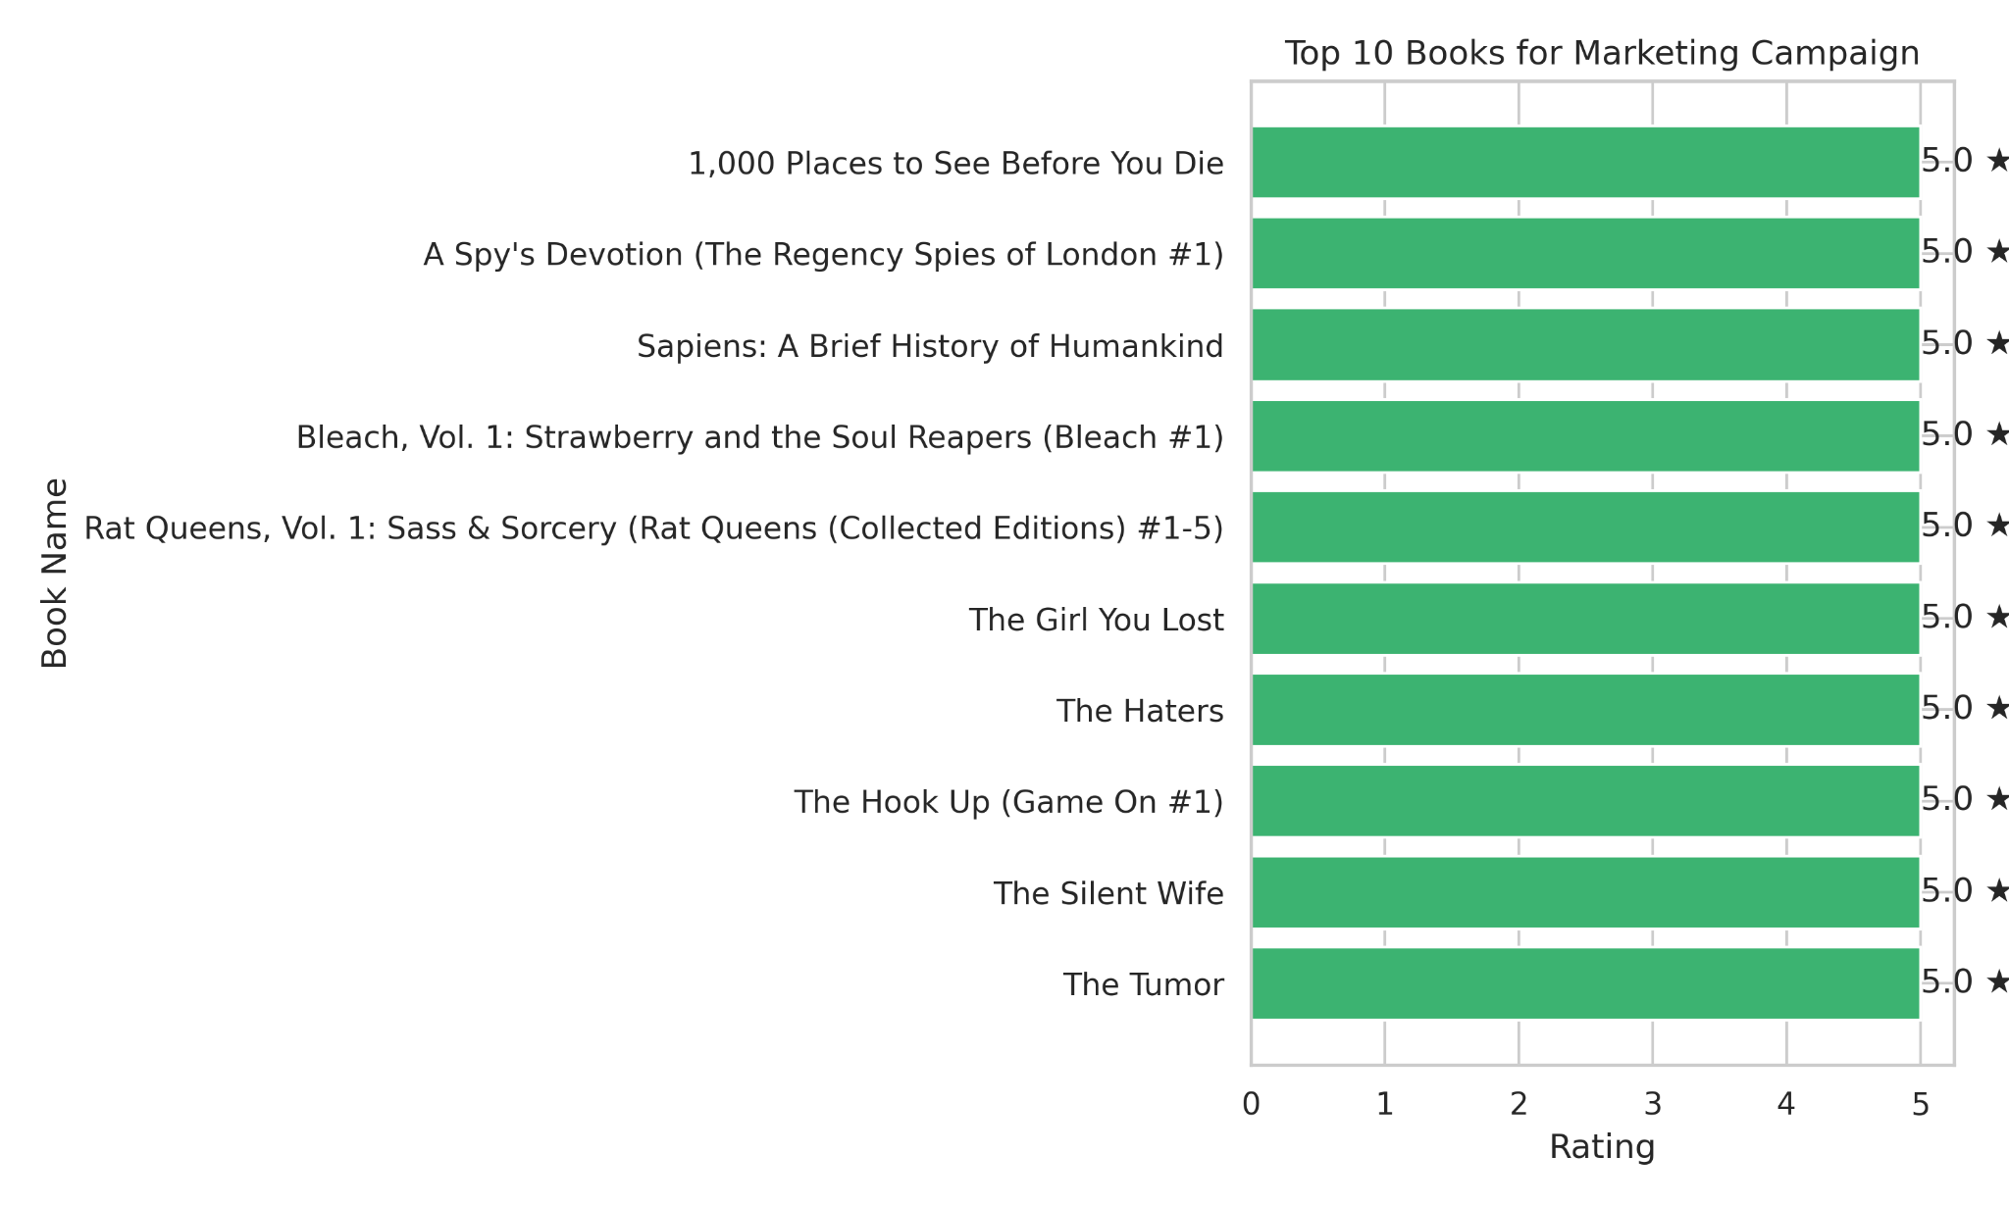
15. Which books could be highlighted in marketing campaigns?

Slide 20
Recommendations :
Pricing & Promotions
Apply 10–20% discount on top 5 high-priced books
Use bundle offers for mid-priced books
Customer Ratings
Promote all 5-star books prominently
Review or improve 1-star books (or consider removal)
Stock & Inventory
Keep high-rated books in stock
Reduce stock or bundle rarely sold books

Slide 21
Recommendations :
Marketing & Upselling
Target 5-star books for cross-selling and upselling
Feature 5-star books in email, social media, and website highlights
Bundle 4-star books with 5-star titles for promotions
Underperforming Books
Investigate 1–2-star high-priced books
Adjust pricing or marketing until issues are resolved
Quality Control
Monitor price-to-rating ratio as a KPI
Ensure accurate descriptions, editorial review, and sample testing

Slide 22
Conclusion
Focus on quality, marketing high-rated books and optimizing inventory to boost sales and customer satisfaction
Thank you

